Slide 1











w e l c o m e
Denver Dev Day – November 17, 2017

Slide 2


Entity Framework Core
Data Access with C#, MySQL and SQL Server
Matt Dixon
Managing Director/Founder
Front Range Systems

Slide 3

Overview
In this session you will learn:
Why .Net Core
Why ORM
Entity Framework Core Basics
Related Entities
Performance Tips
Raw SQL, and Stored Procedures
Transactions
Notes:
Test notes

Slide 4
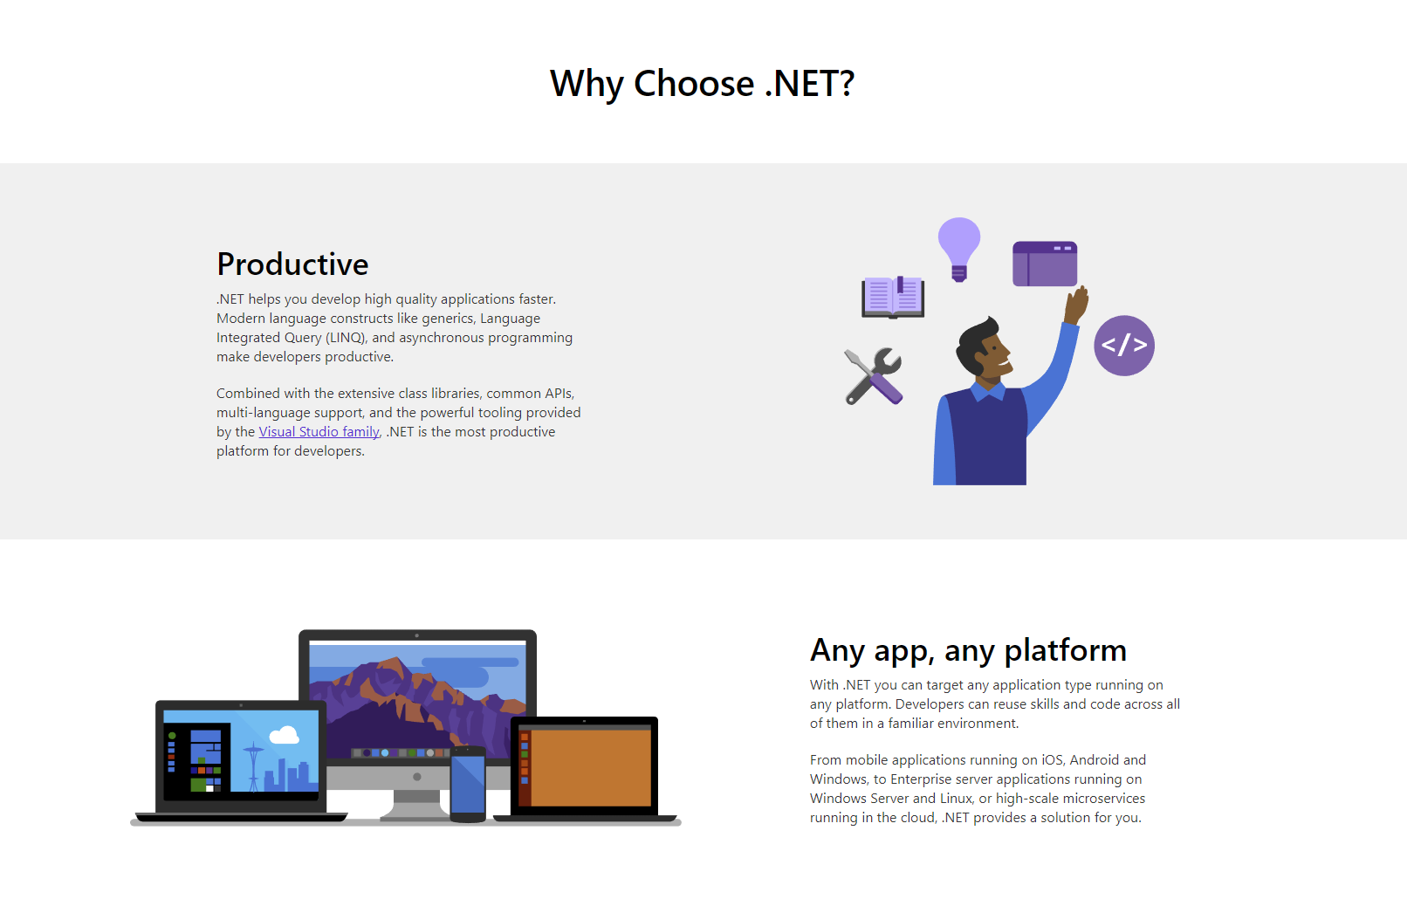
Why .Net Core
Notes:
Test notes

Slide 5
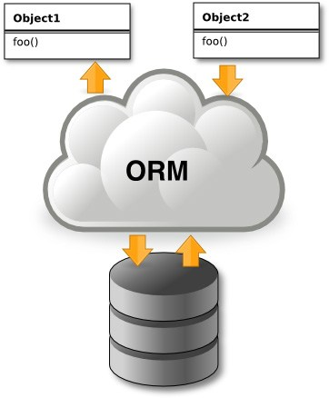
Why ORM
Turns relational data into objects
No inline SQL Statemetns
Pure Magic
Notes:
Test notes

Slide 6
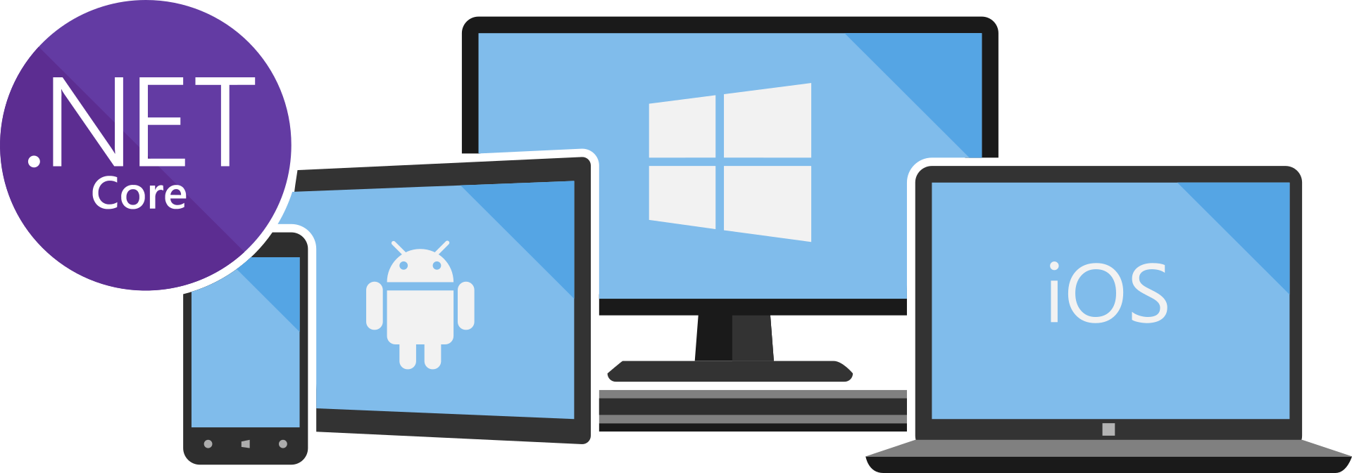
Entity Framework Core Basics
Entity Framework Core Basics
Notes:
Test notes

Slide 7
Loading Related Entities
Parent
Parent
Child
Child
Child
Child
Child
Notes:
Test notes

Slide 8
Performance Tips
Notes:
Test notes

Slide 9
Raw SQL and Stored Procedures
Notes:
Test notes

Slide 10
Transactions
Notes:
Test notes

Slide 11
Resources
http://bit.ly/frs-efcore
Notes:
Test notes

